Slide 1



UNIVERSITY INSTITUTE OF ENGINEERING
COMPUTER SCIENCE ENGINEERING
Bachelor of Engineering
Design and Analysis of Algorithms Lab(CSP-309/ITP-309)
Topic: Algorithms and Program Performance
DISCOVER . LEARN . EMPOWER

Slide 2

Designing and analyzing algorithms
An Algorithm is a sequence of steps to solve a problem.
Design and Analysis of Algorithm help to design the algorithms for solving different types of problems in Computer Science. It also helps to design and analyze the logic on how the program will work before developing the actual code for a program.

Slide 3
Designing and analyzing algorithms
An algorithm is an efficient method that can be expressed within finite amount of time and space.
An algorithm is the best way to represent the solution of a particular problem in a very simple and efficient way. If we have an algorithm for a specific problem, then we can implement it in any programming language, meaning that the algorithm is independent from any programming languages.

Slide 4
Algorithm Design
creating an efficient algorithm to solve a problem in an efficient way using minimum time and space.
To solve a problem, different approaches can be followed.
Some are efficient with respect to time consumption
Some are memory efficient.
keep in mind that both time consumption and memory usage cannot be optimized simultaneously.

Slide 5
Difference between Algorithm and Pseudocode
Algorithm
Pseudocode
An algorithm is a formal definition with some specific characteristics that describes a process.
Generally, the word "algorithm" can be used to describe any high level task in computer science.
Pseudocode is an informal and (often rudimentary) human readable description of an algorithm.
Writing a pseudocode has no restriction of styles and its only objective is to describe the high level steps of algorithm in a much realistic manner in natural language.

Slide 6
Analysis of Algorithm
It is common to estimate their complexity in the asymptotic sense.
Analysis of algorithms is the determination of the amount of time and space resources required to execute it.
A function relating the input length to the number of steps, known as time complexity, or volume of memory
Generally, we perform the following types of analysis −
Worst-case − The maximum number of steps taken on any instance of size a.
Best-case − The minimum number of steps taken on any instance of size a.
Average case − An average number of steps taken on any instance of size a.
space complexity.

Slide 7
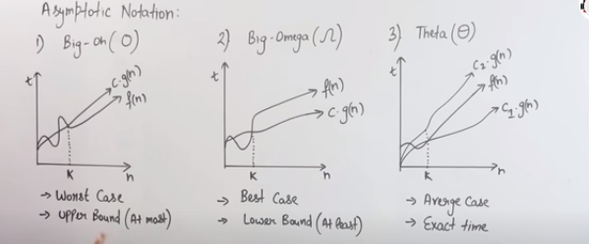
Asymptotic notations
Mathematical way of representing time complexity

Slide 8
Asymptotic notations
The asymptotic behavior of a function f(n) refers to the growth of f(n) as n gets large.
We typically ignore small values of n, since we are usually interested in estimating how slow the program will be on large inputs.
A good rule of thumb is that the slower the asymptotic growth rate, the better the algorithm. Though it’s not always true.
For example, a linear algorithm f(n)=d∗n+kf(n)=d∗n+k is always asymptotically better than a quadratic one, f(n)=c.n2+qf(n)=c.n2+q.

Slide 9
Recurrence equations and their solution
Substitution method,
Recursion-tree method
Master method.

Slide 10
THANK YOU

